Slide 1
Lyra - amendments

Slide 2
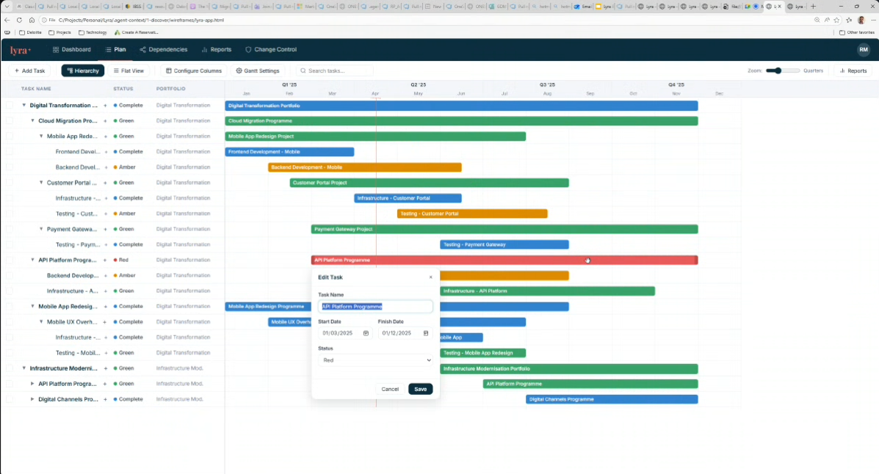
Tasks are structured in a hierarchy with no limit to the number of branches.
Tasks can be moved by selecting the task (check box to the left) and dragging and dropping.
If a parent task is moved, the child tasks must move with it.
If a user selects a parent task, the child tasks should be highlighted but not be active unless the user starts to move the task.
If a parent task is marked completed the child tasks % complete fields should be highlighted, user can hit return to make them also marked as completed
Remove the progress bar on the % complete, only show the number
If a parent task is deleted, user should be asked if the child tasks should also be deleted
Replace configure columns and gantt settings with a single ‘settings’ button and combine the contents of each

Slide 3
Tasks are structured in a hierarchy with no limit to the number of branches.
Tasks can be moved by selecting the task (check box to the left) and dragging and dropping.
If a parent task is moved, the child tasks must move with it.
If a user selects a parent task, the child tasks should be highlighted but not be active unless the user starts to move the task.
If a parent task is marked completed the child tasks % complete fields should be highlighted, user can hit return to make them also marked as completed
Remove the progress bar on the % complete, only show the number
If a parent task is deleted, user should be asked if the child tasks should also be deleted
Replace the buttons for “configure columns” and “gantt settings” with a single ‘settings’ button and combine the contents of each

Slide 4
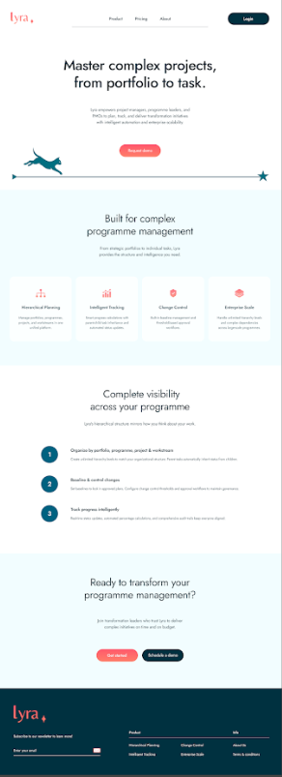
This is the Lyra Landing page
Replicate exactly
Login button to navigate to the home screen

Slide 5
home screen
Navigation panel at top. Add ‘Home’ to the first of the options on the navigation panel and have this persist on every screen
On the home screen, under the navigation panel is a hierarchical tree structure of projects user has access to. User can switch to an alphabetical list.
Keep formatting, look and feel of the screen shot opposite

Slide 6
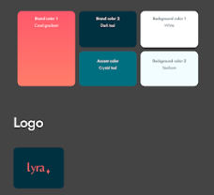
Entire app
Use this colour scheme, look and feel throughout.
Keep the existing screen structures but replace the branding fonts and colours with these
All fonts throughout Lyra must use the fonts and colours from the screenshots only

Slide 7
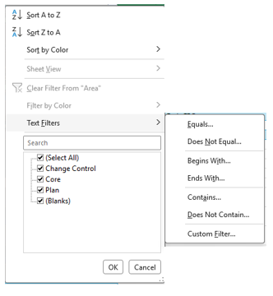
Report screen changes
2. List of all columns set up in plan appears. When user hovers on item, contents of column appears for user to select. If many items in list, user clicks on column name e.g project and then can search or type project name. can multi select
Gantt Filter
Select column
Programme
Programme 1
Project
Programme 2
1. User clicks on drop down and sees all columns set up in plan
Programme n
This is the equivalent of the list of all the columns

